Slide 1

Week 10/03/2023

Slide 2
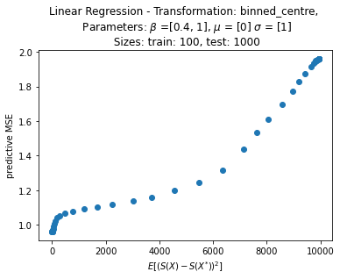
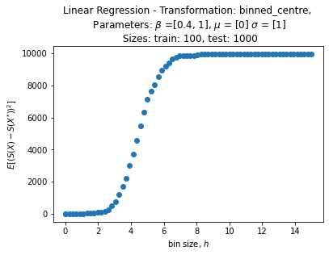
Univariate linear regression

Slide 3
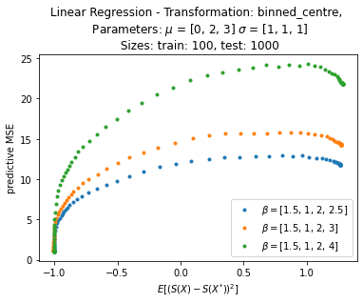
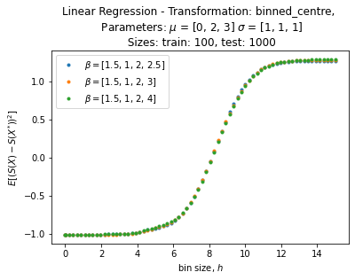
Extension to multivariate linear regression
3 DIMENSIONS – CHANGING BETA3

Slide 4
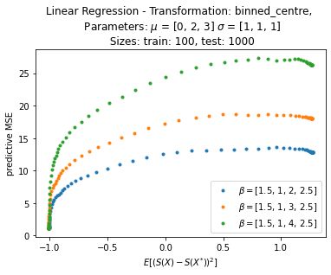
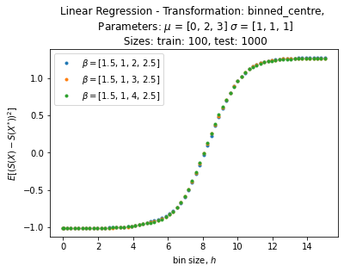
Extension to multivariate linear regression
3 DIMENSIONS – CHANGING BETA2

Slide 5
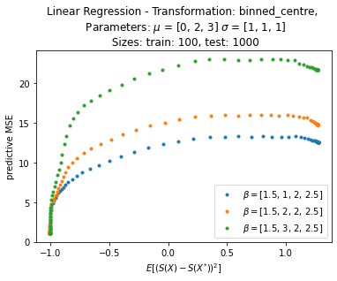

Extension to multivariate linear regression
3 DIMENSIONS – CHANGING BETA1

Slide 6
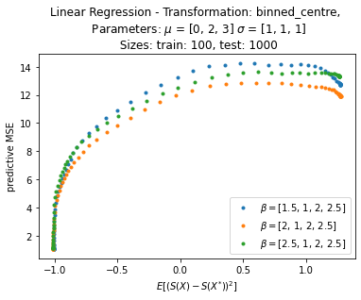
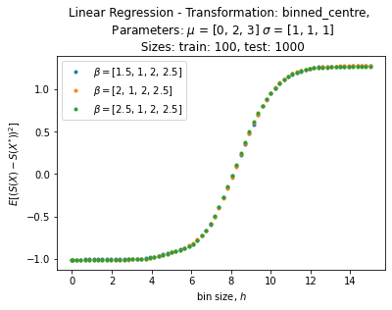
Extension to multivariate linear regression
3 DIMENSIONS – CHANGING BETA0

Slide 7
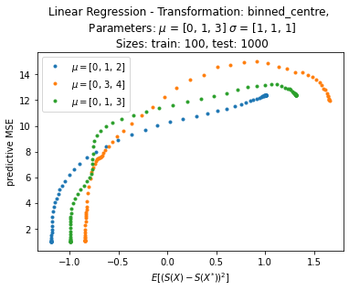
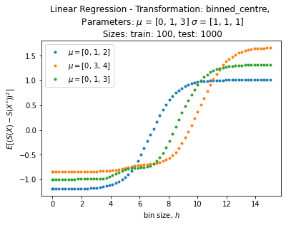
Extension to multivariate linear regression
3 DIMENSIONS – CHANGING MEANS

Slide 8
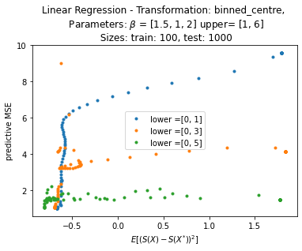
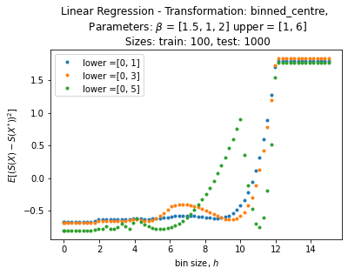
Extension to multivariate linear regression
3 DIMENSIONS – X sampled uniformly

Slide 9
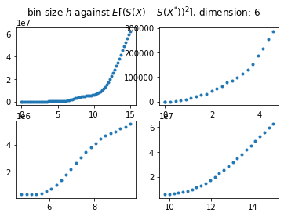
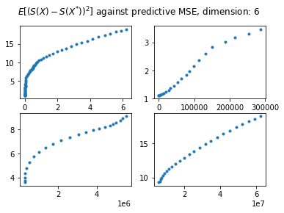

Extension to multivariate linear regression
6 DIMENSIONS

Slide 10
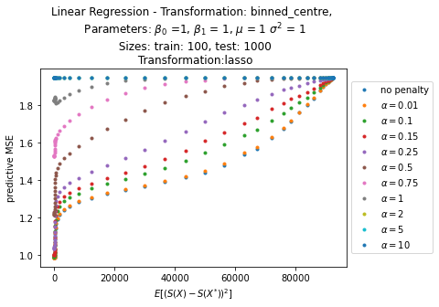
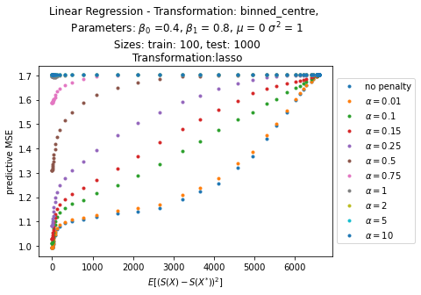
LINear regression
PLAYING WITH LASSO
Convexity changes around 0.15
Convexity changes around 0.1

Slide 11
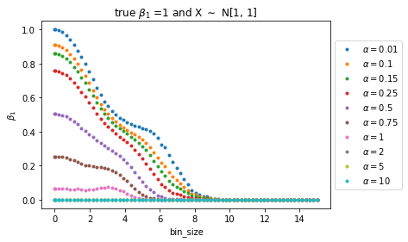
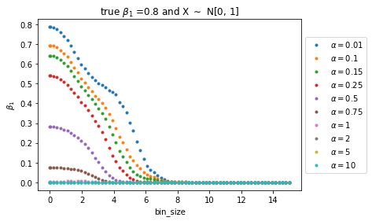
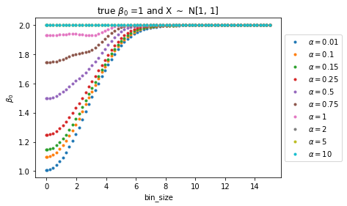
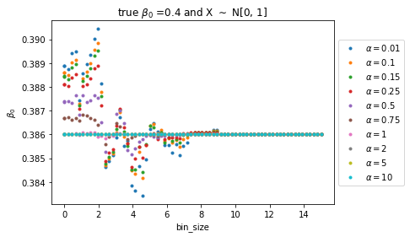
LINear regression
PLAYING WITH LASSO

Slide 12
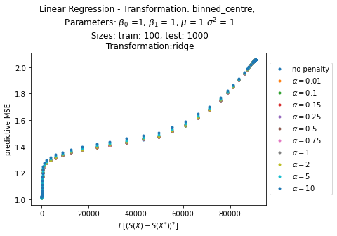
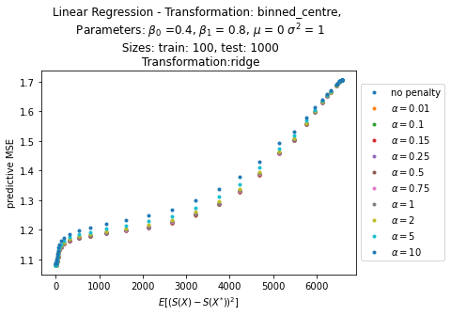
LINear regression
PLAYING WITH RIDGE

Slide 13
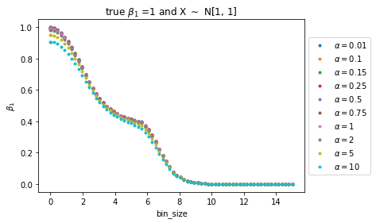
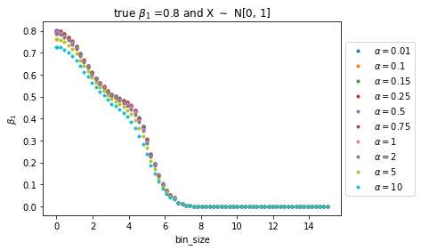
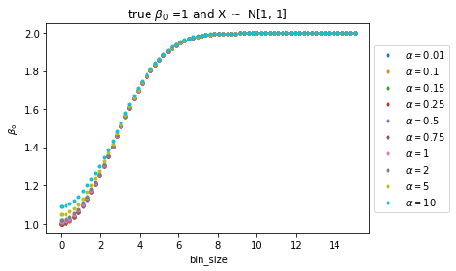
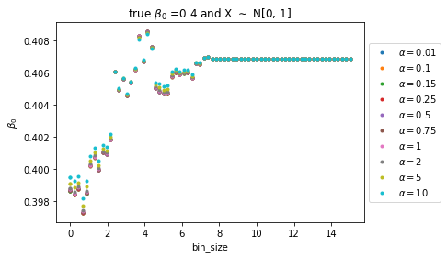
LINear regression
PLAYING WITH RIDGE

Slide 14
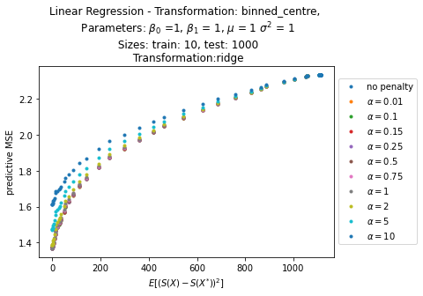
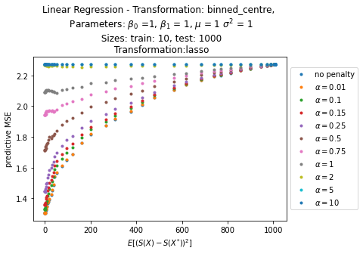
LINear regression
VARIOUS PENALTIES

Slide 15
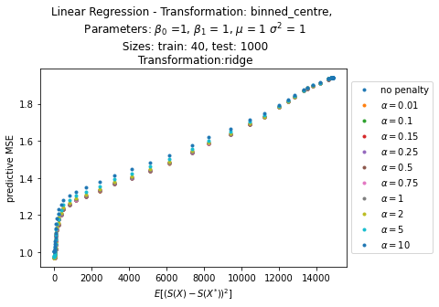
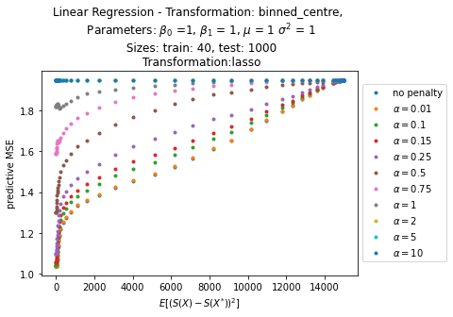
LINear regression
VARIOUS PENALTIES
Higher alpha has the same effect as a smaller train size?

Slide 16
CART

